Slide 1
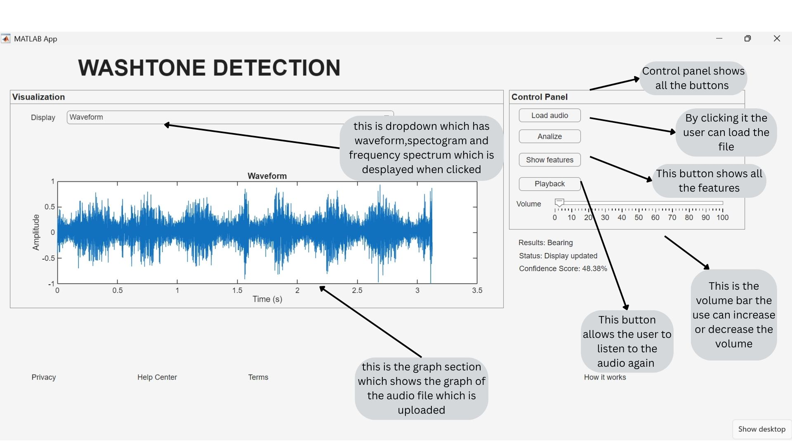

Slide 2
WASHTONE DETECTOR
Overview
This project is an audio-based fault detection application designed to identify anomalies in industrial machinery using sound analysis. The system enables non-invasive, scalable, and cost-effective monitoring, supporting predictive maintenance strategies.
Intended End User
The primary users are maintenance engineers working in industrial environments such as manufacturing plants. These users are responsible for monitoring equipment health and preventing unexpected failures.
Value Proposition
Non-invasive monitoring (no physical sensors required)
Lower cost compared to vibration-based systems
Scalable across multiple machines
Enables early fault detection through acoustic anomalies
Supports predictive maintenance and reduces downtime

Slide 3
Features
Load and analyze audio files
Playback functionality with volume control
Real-time status, result, and scoring display
Visualization tools
Waveform
Spectrogram
Frequency spectrum
User Workflow
Open the application interface by clicking on app1.mlapp and run the app
Load an audio file by clicking load audio file button
Click the "Analyze" button
View results and system status
Playback audio if needed
Adjust volume using the sidebar
Review score and detection output
Select visualization type from dropdown
Technical Stack
Audio Processing: MATLAB
Machine Learning: Classification Learner
Frontend: MATLAB app builder
Visualization: Matplotlib

